Slide 1
iLearn~iExperience~iShare
Susan Brandon
Danielle Abernethy

Slide 3
iLearn & iExperience with Webquests

Slide 4
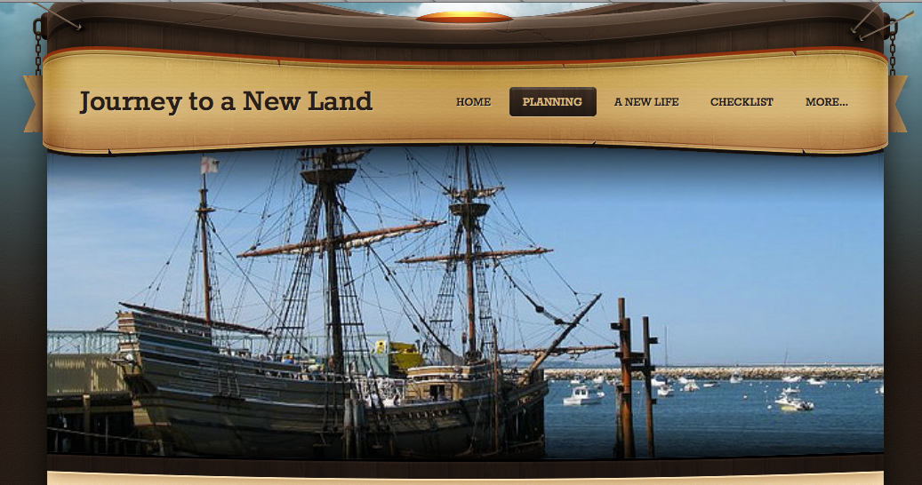
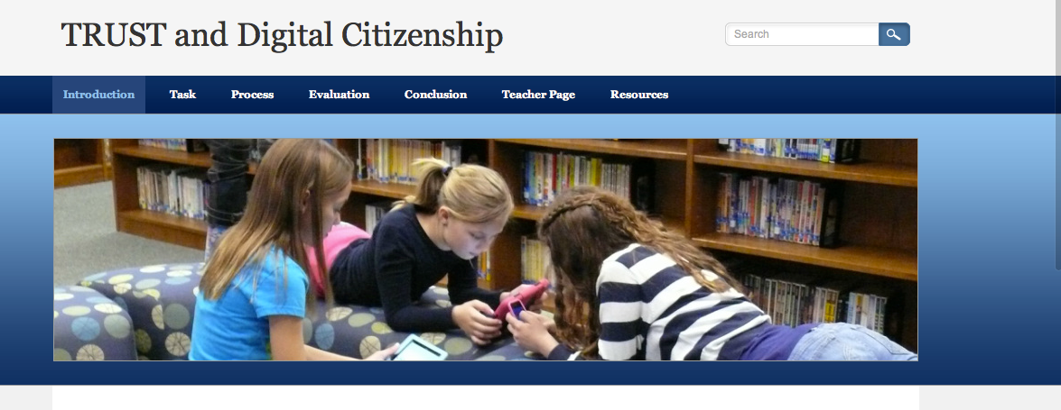
W
E
B
Q
U
E
S
T
S

Slide 5
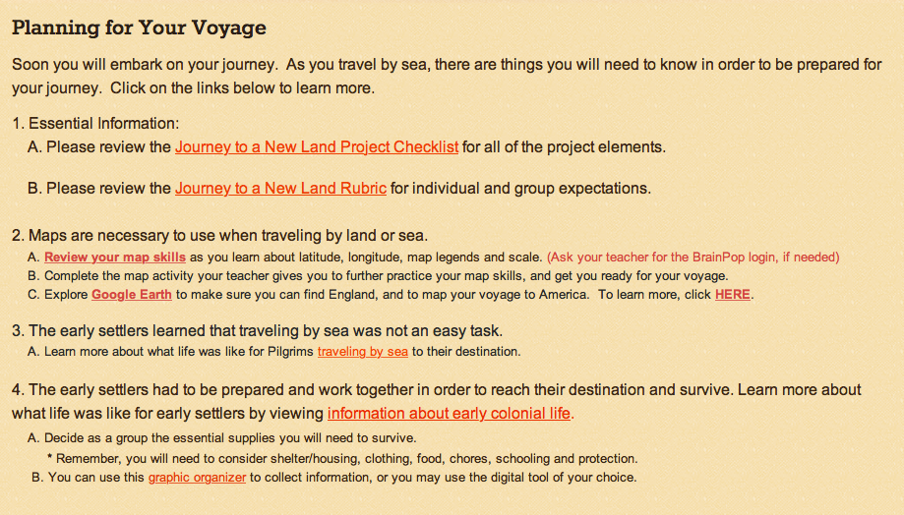
Plan~Process~Product

Slide 6
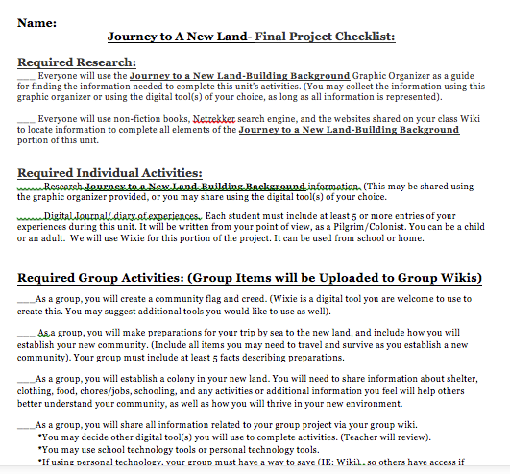
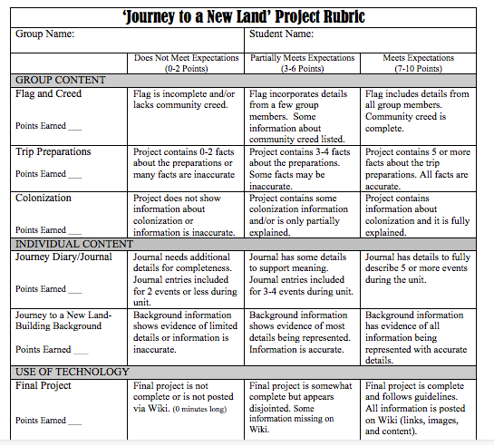
Expectation
Assessment

Slide 7
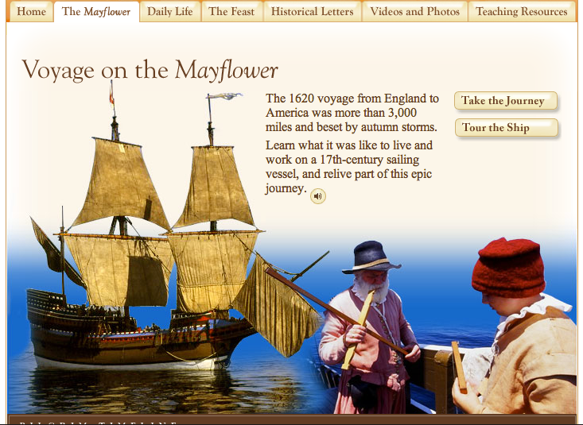
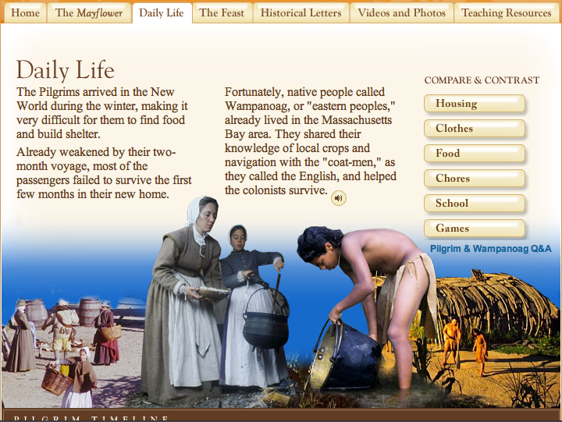
http://www.scholastic.com/scholastic_thanksgiving/

Slide 9
No Time to
“Create” a Webquest?

Slide 10
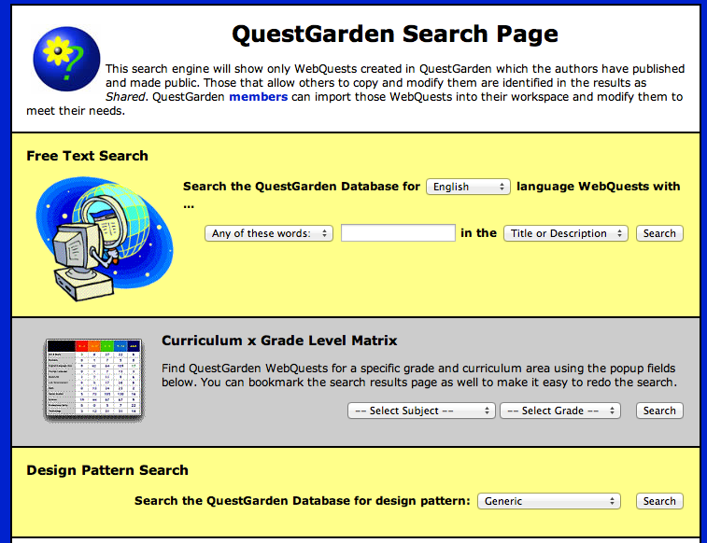
http://questgarden.com

Slide 11
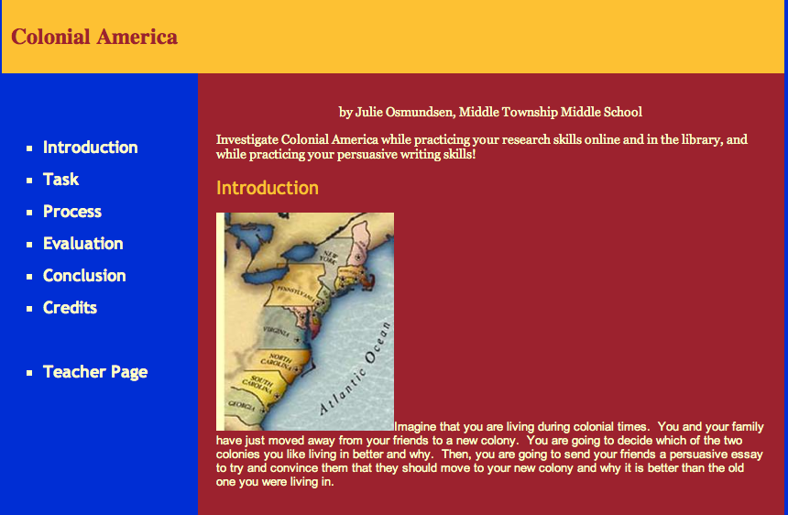
Webquests

Slide 12
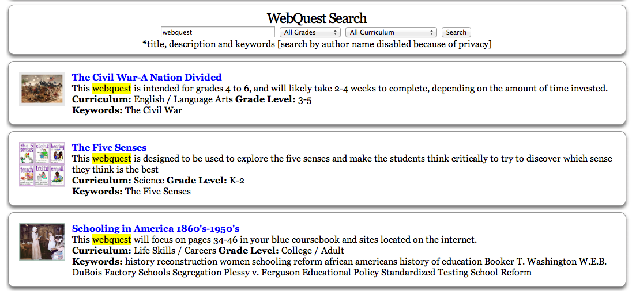
Zunal Webquests
http://zunal.com

Slide 13
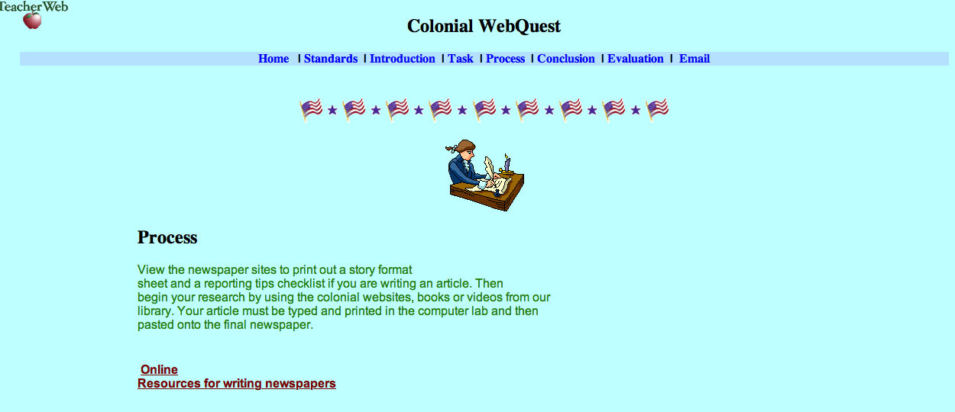
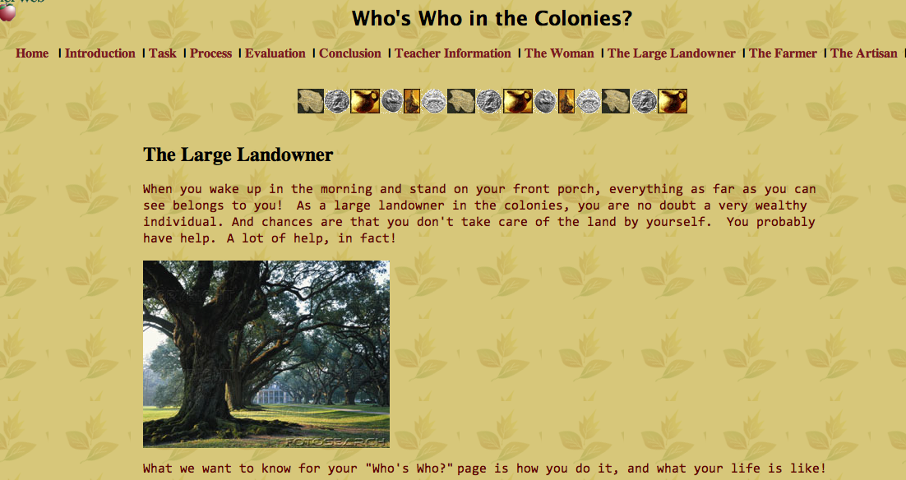
http://www.teacherweb.com

Slide 14
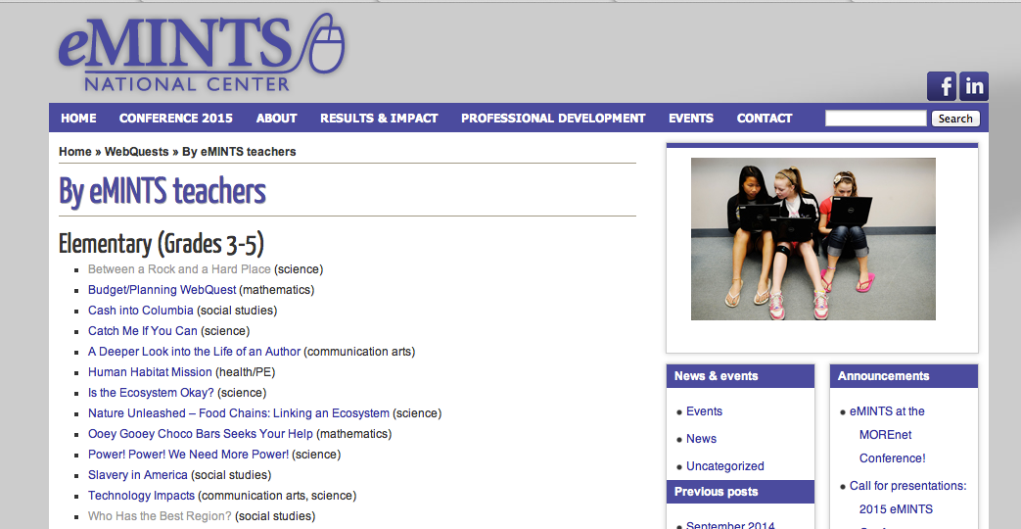
eMints Webquests
E-Mints Webquests

Slide 15
Symbaloo
http://www.symbalooedu.com

Slide 16
iCreate With Apps
& WebTools

Slide 17
Device Capabilities
What can your device do?

Slide 20
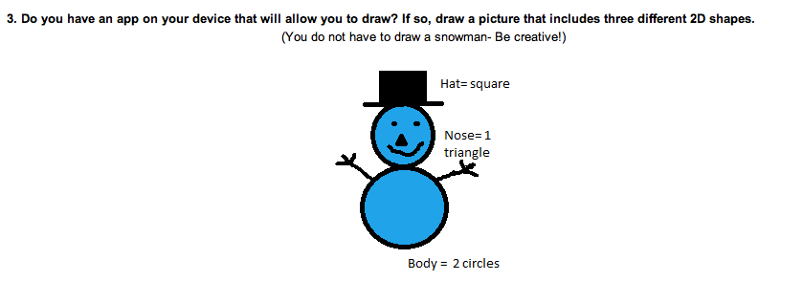
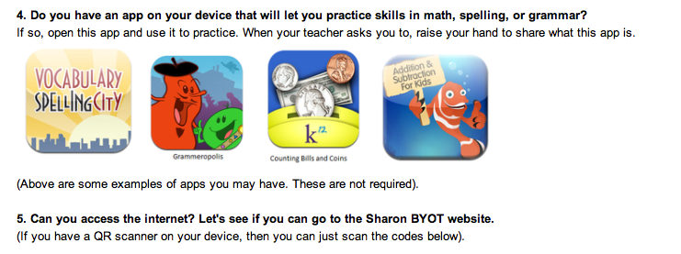

Slide 21
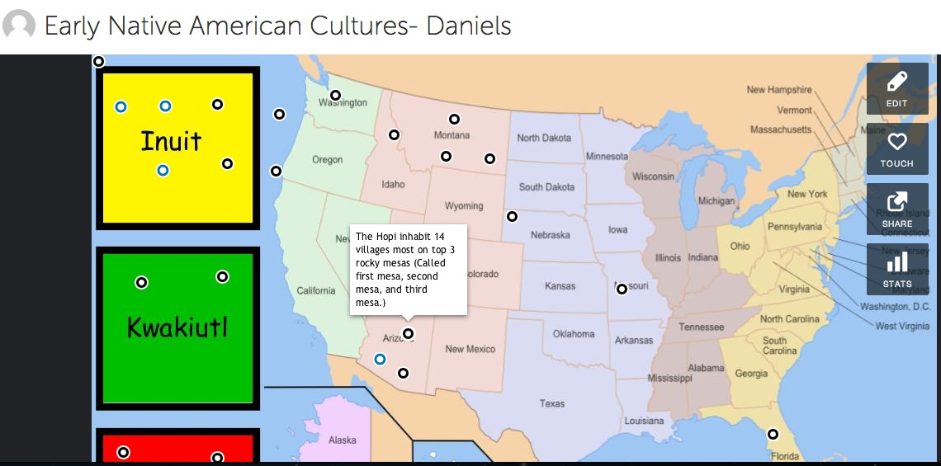
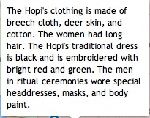
Thing Link
https://www.thinglink.com

Slide 22
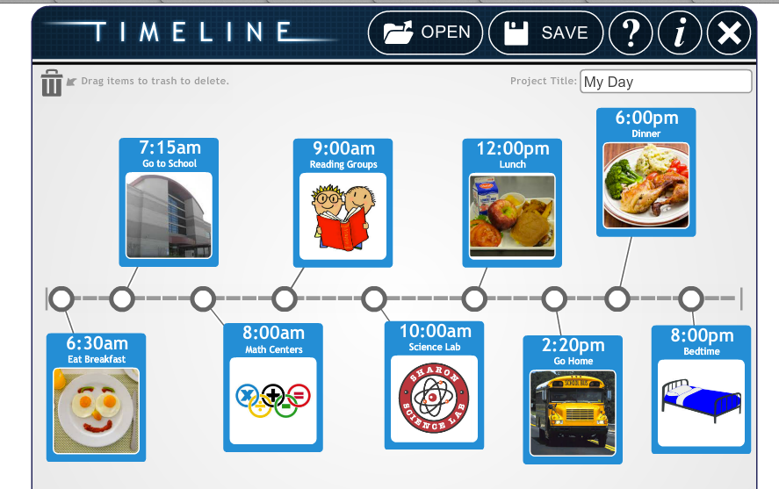
Interactive Timeline
ReadWriteThink Interactive Timeline

Slide 23
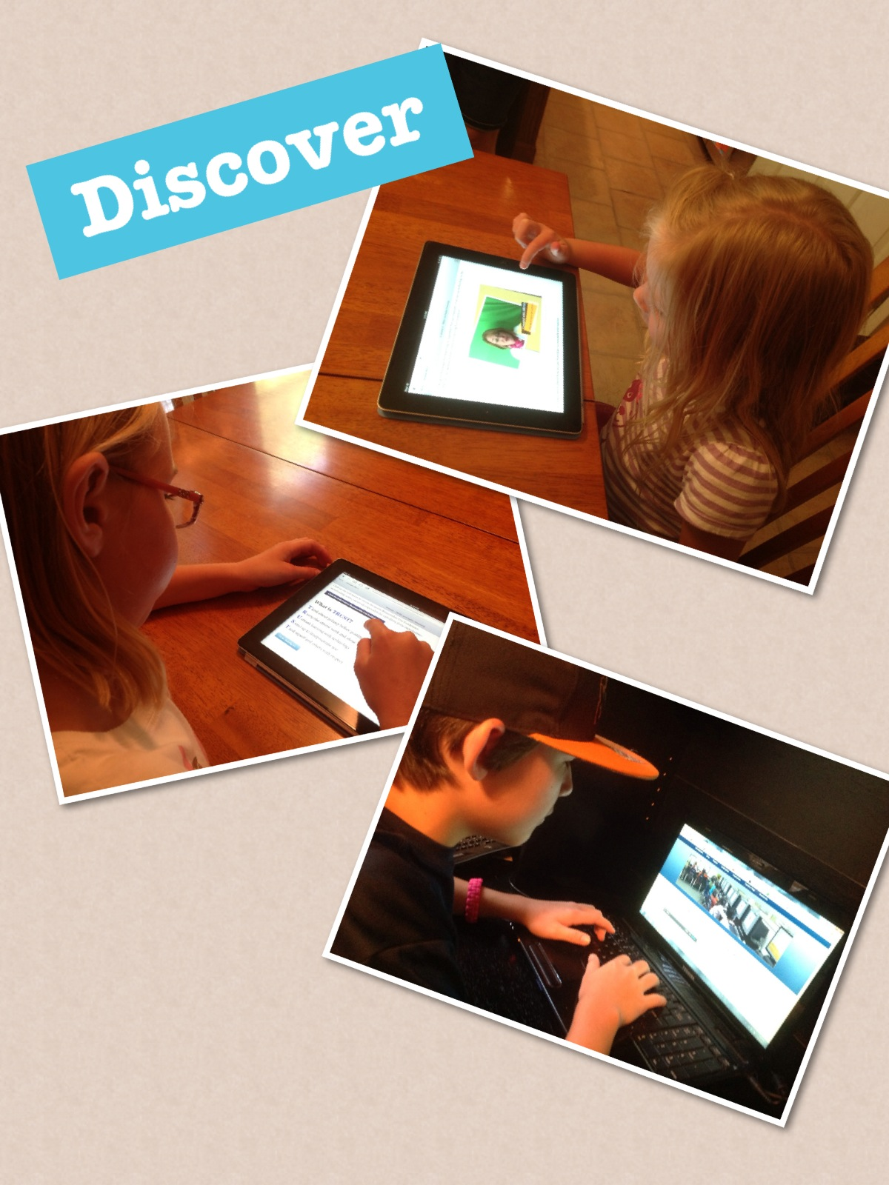
Photo Collage Apps
They aren’t just
for ‘selfies’

Slide 24
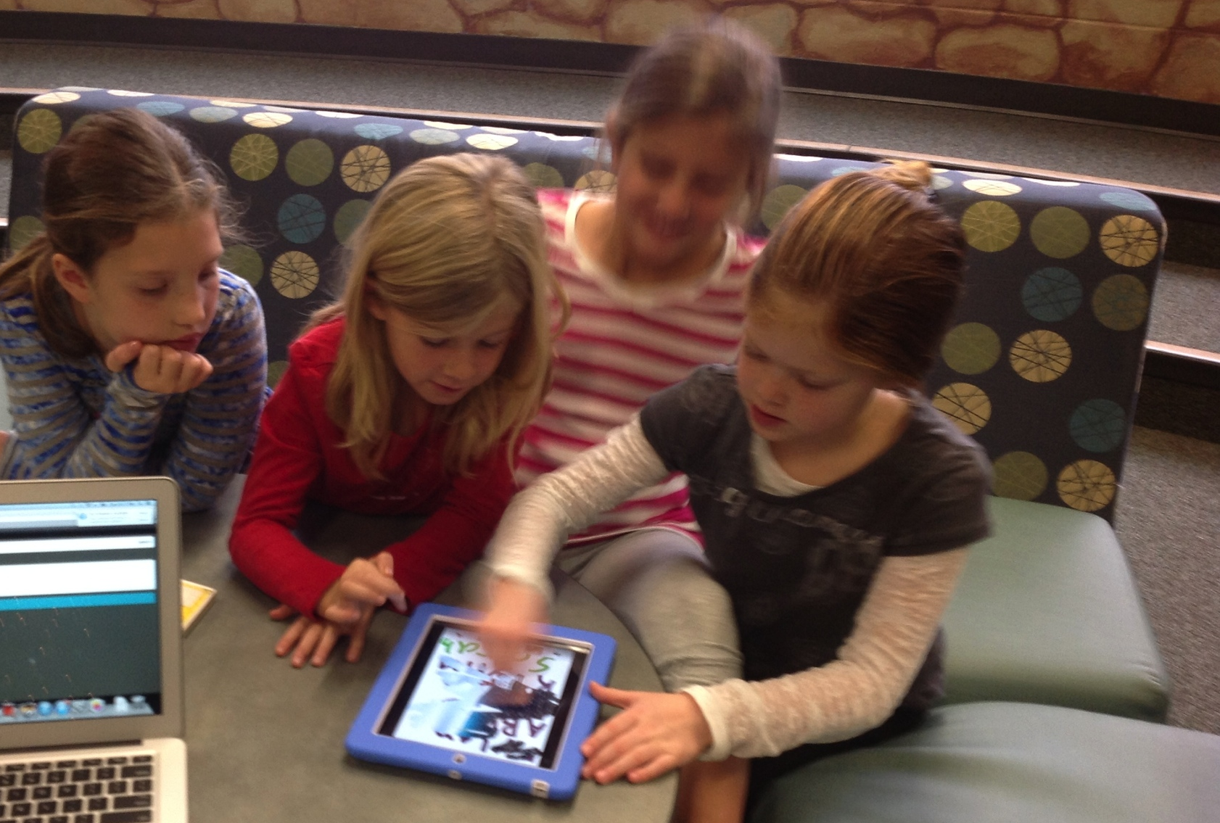
Photo & Drawing Apps
Share Classroom Learning
Assess Learning
Document Progress
Collaboration
Communication
Creativity

Slide 25
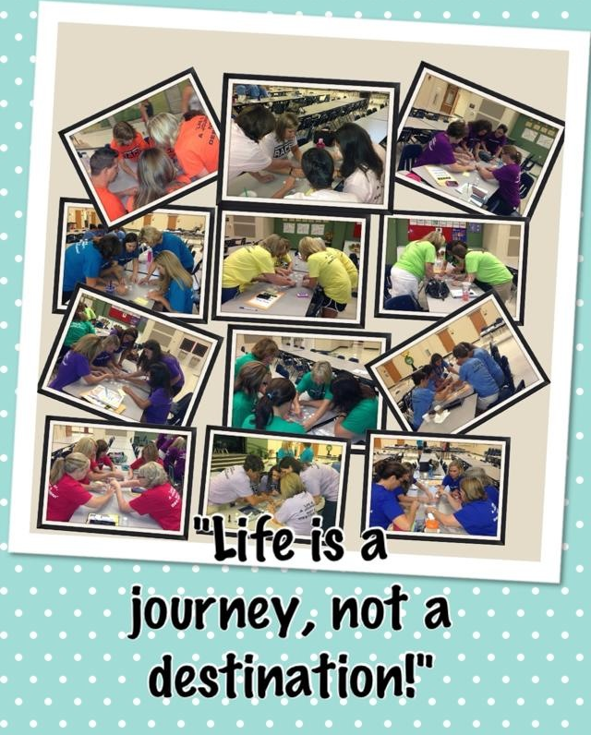
Pic Collage

Slide 26
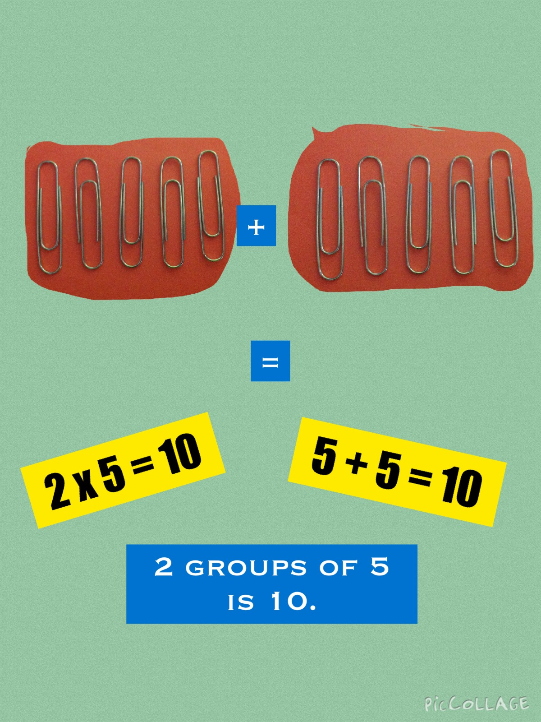
How Many
Ways
Can You
Make 10?

Slide 27
Word
Problems

Slide 28
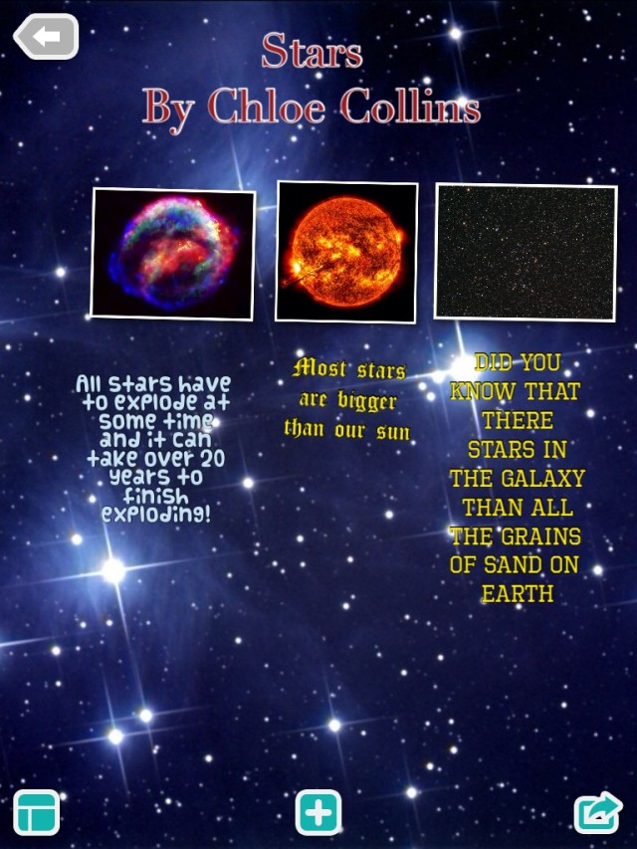

Slide 30
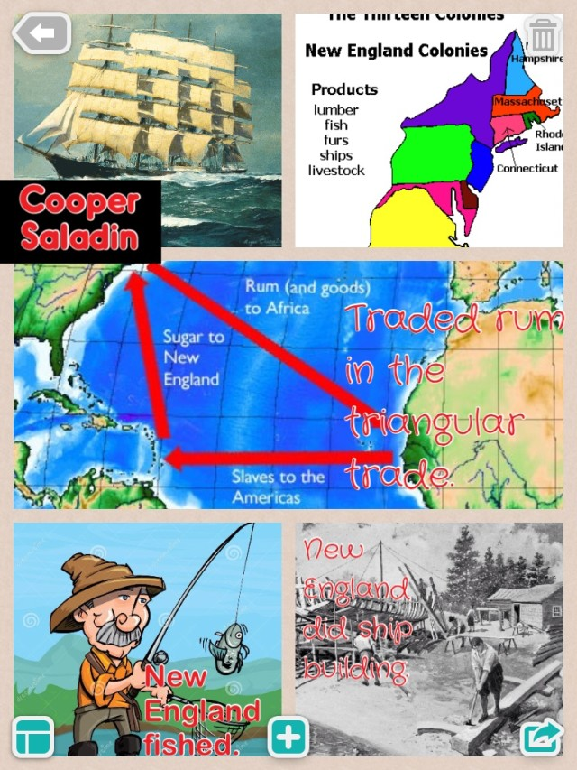

Slide 33
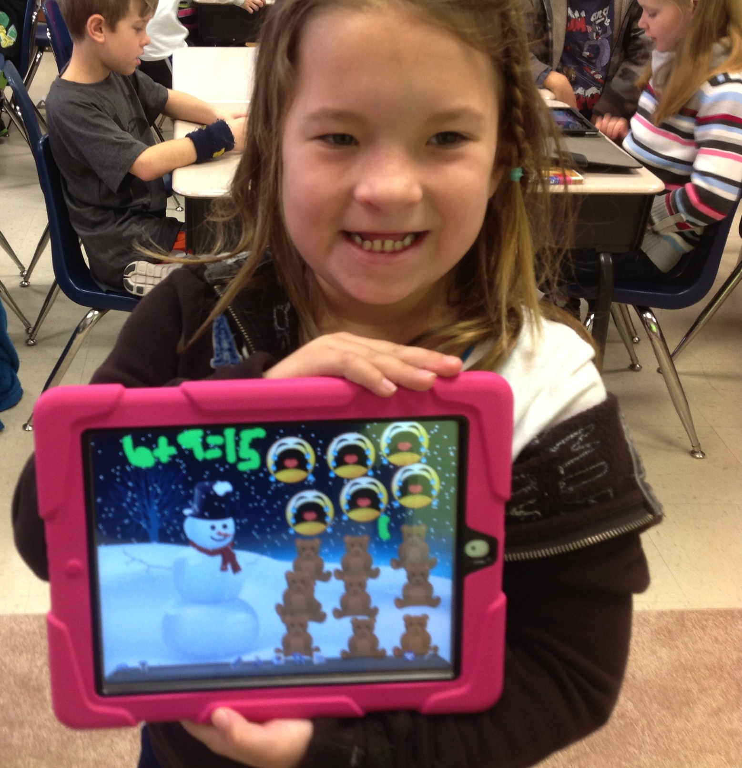
D
O
O
D
L
E
B
U
D
D
Y

Slide 34
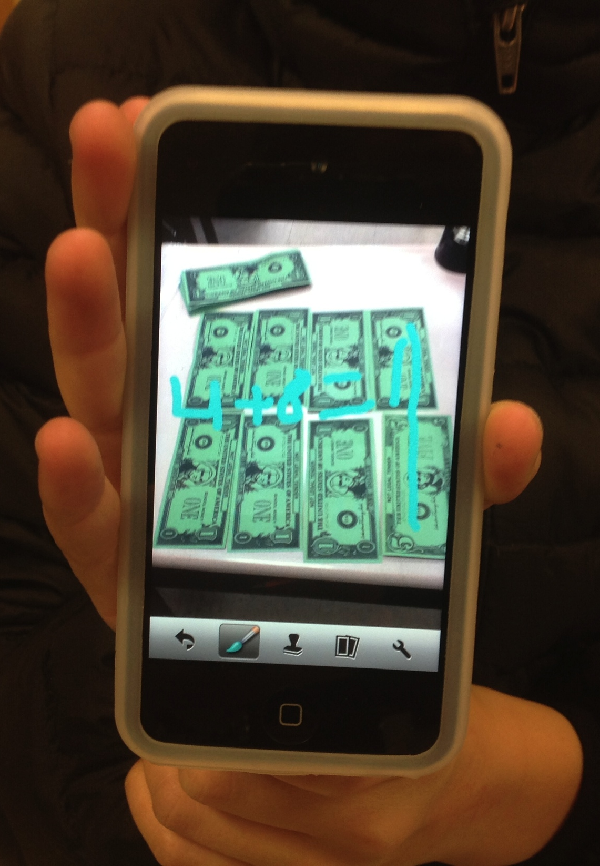
Sorting & Counting

Slide 35
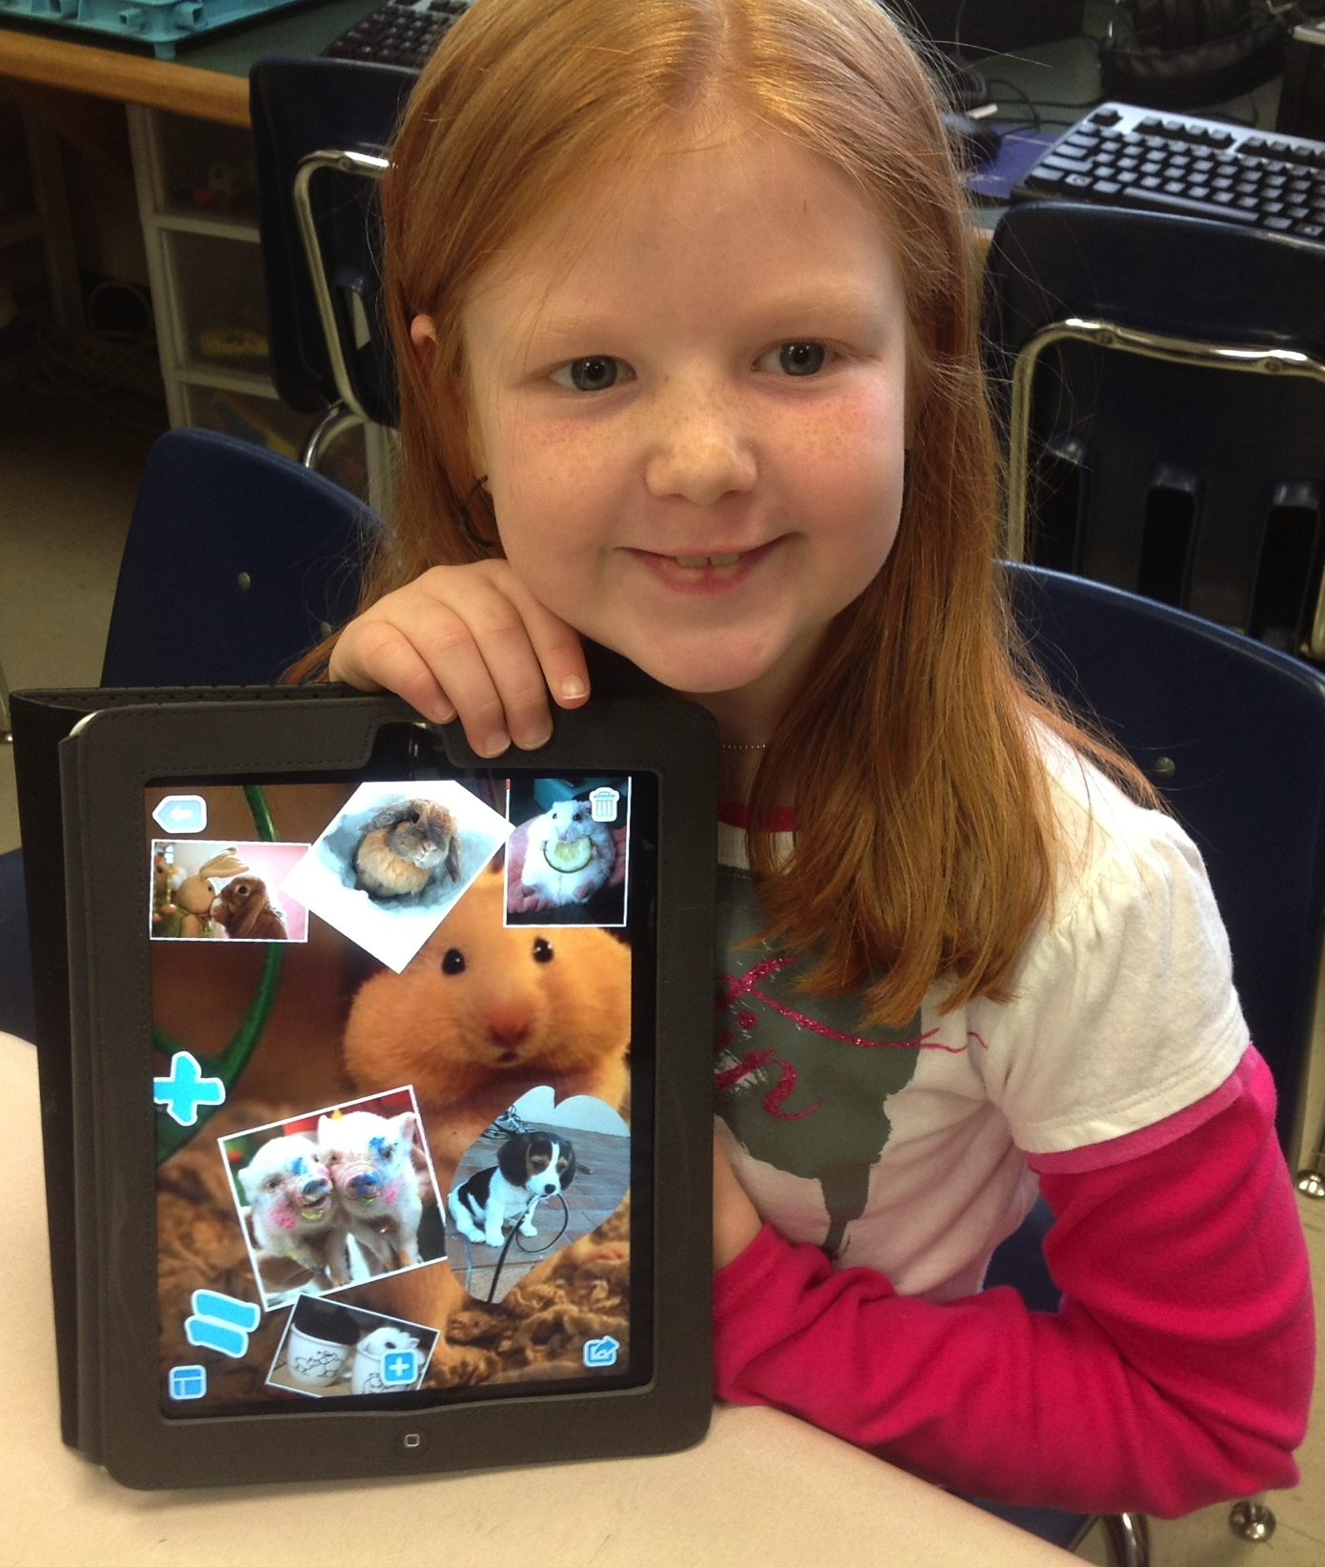
Counting
Animals

Slide 36
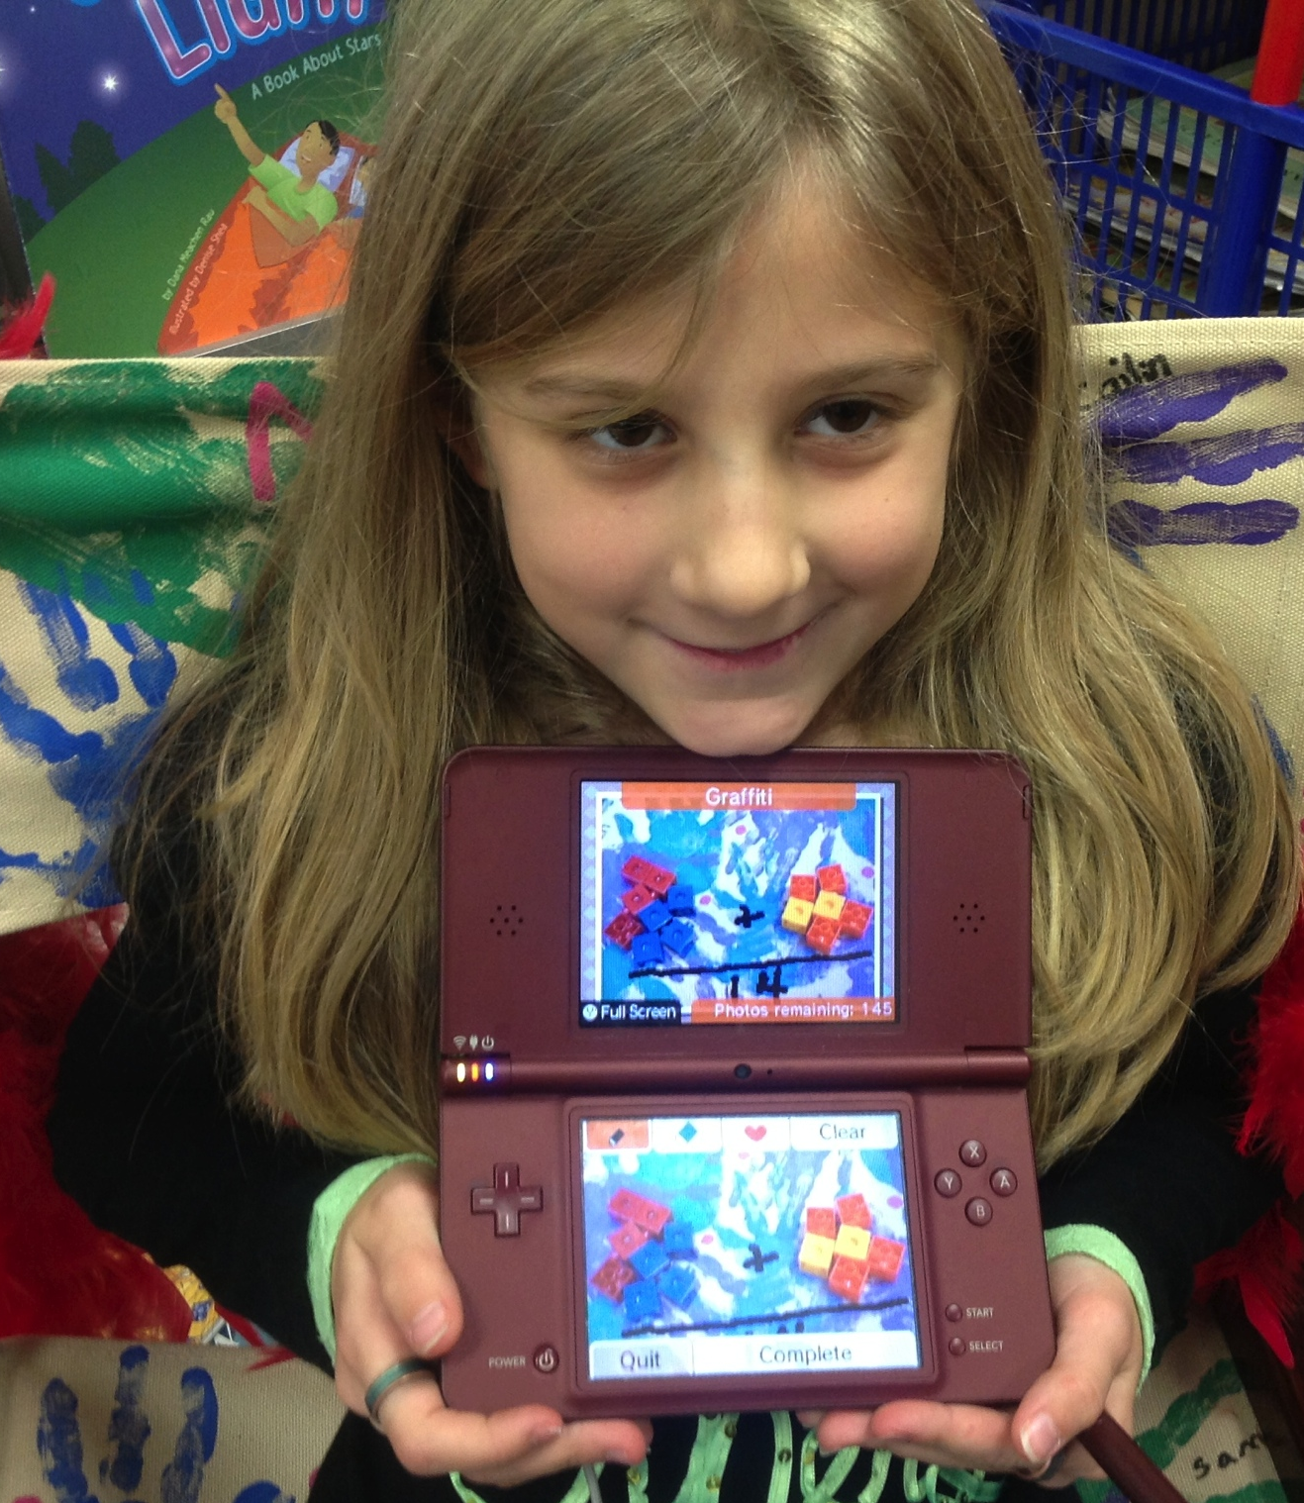
Nintendo
DSi

Slide 37
Skitch
Take a Photo
&
Annotate

Slide 39
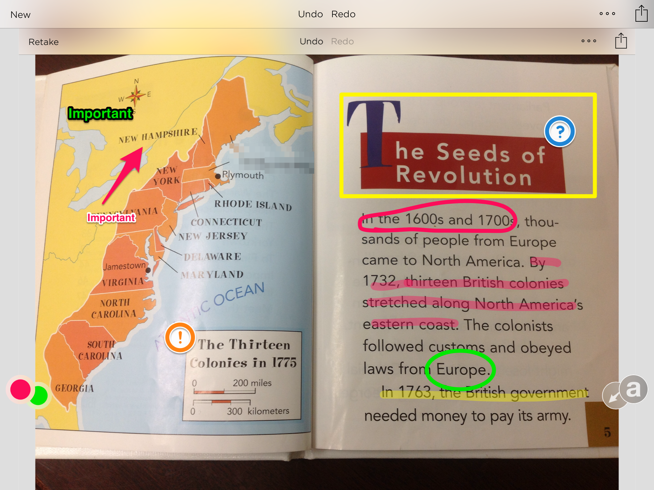
Skitch

Slide 40
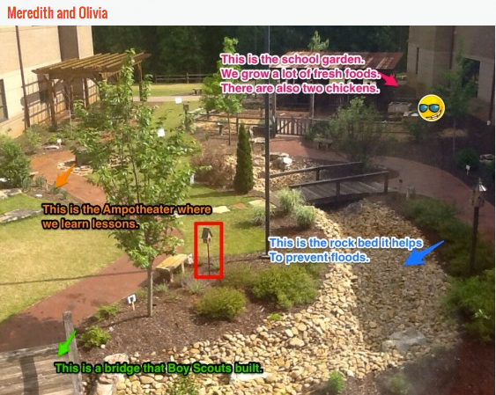
Skitch

Slide 41
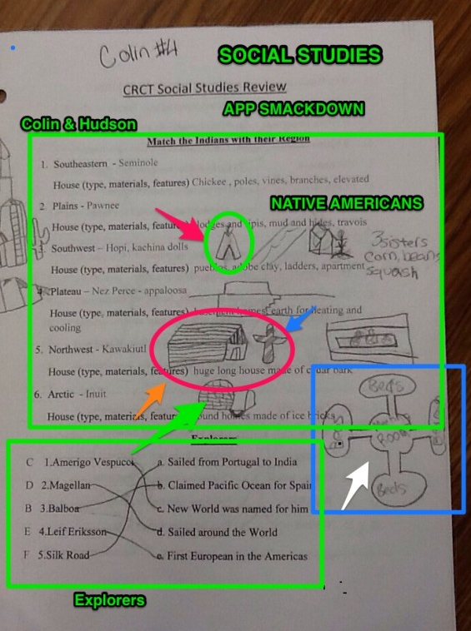
Taking
Notes

Slide 42
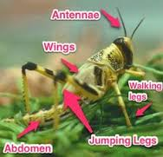
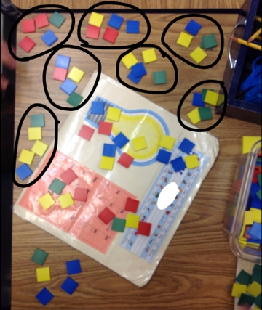
Grouping
Labeling

Slide 43
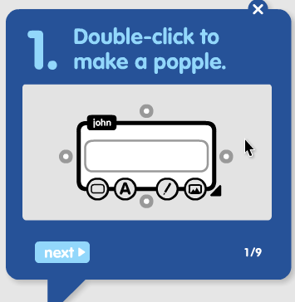
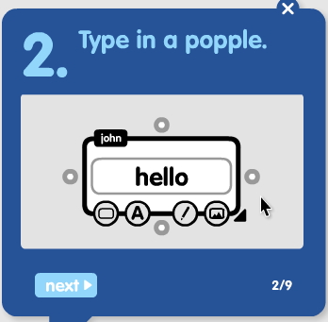
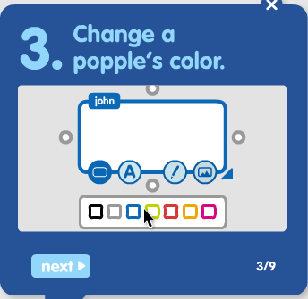
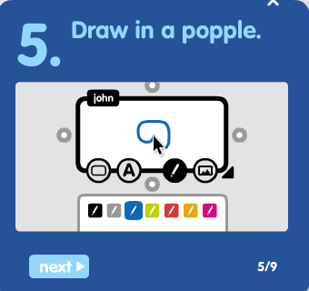
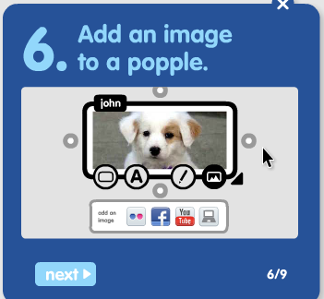
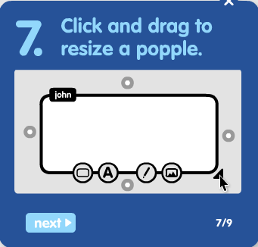
Popplet
http://popplet.com

Slide 44
Life Cycle Popplet

Slide 46
Abraham Lincoln

Slide 47
Revolutionary War

Slide 48
3 Branches of Government

Slide 49
Padlet
https://padlet.com/auth/login
images
website links
information

Slide 50
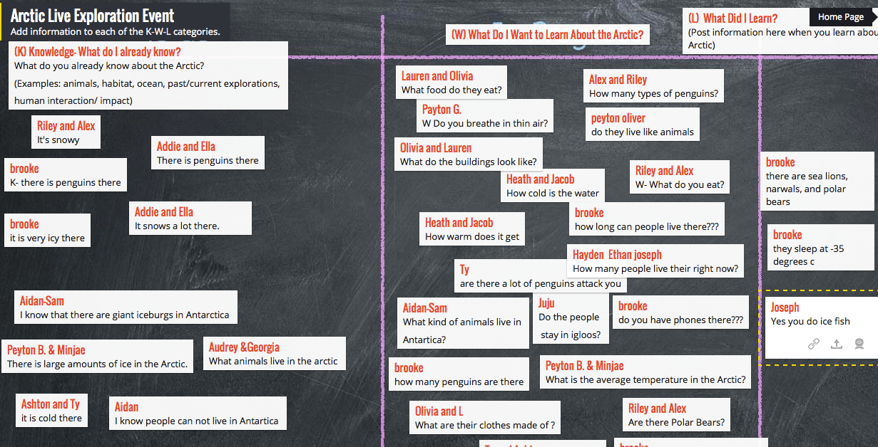
Padlet- KWL

Slide 51
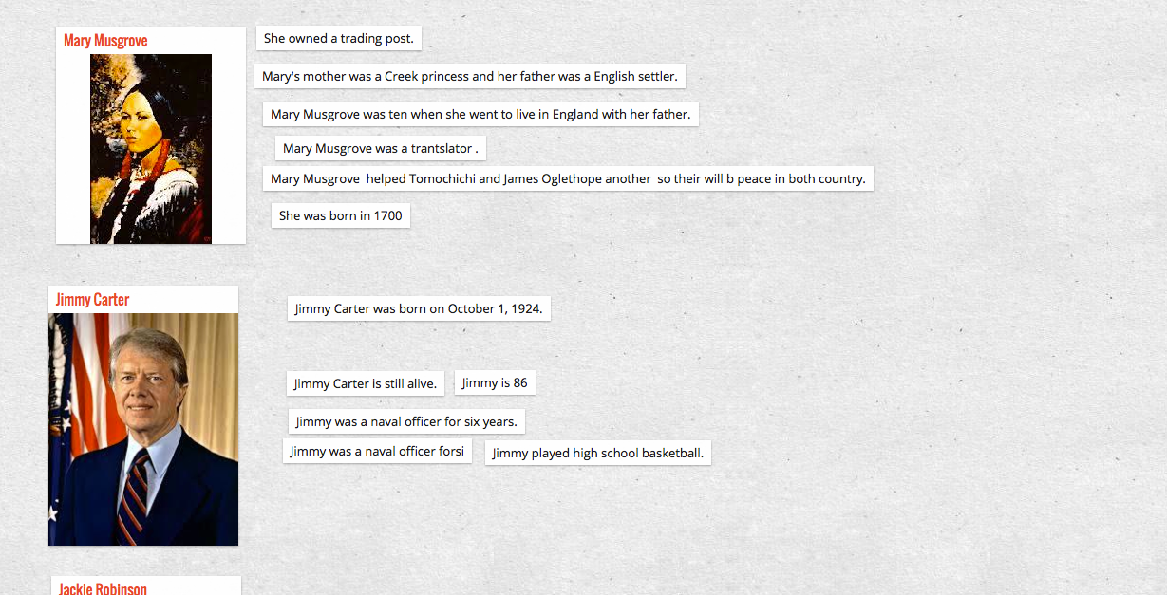

Slide 52
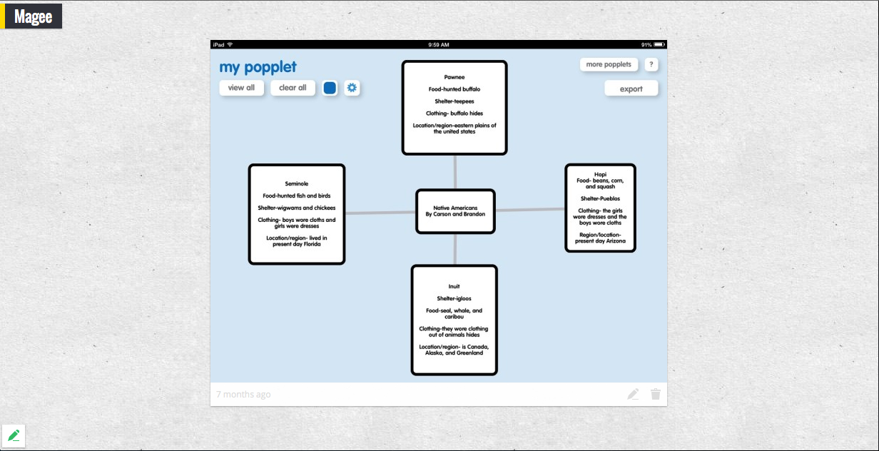

Slide 54
https://www.wixie.com

Slide 55
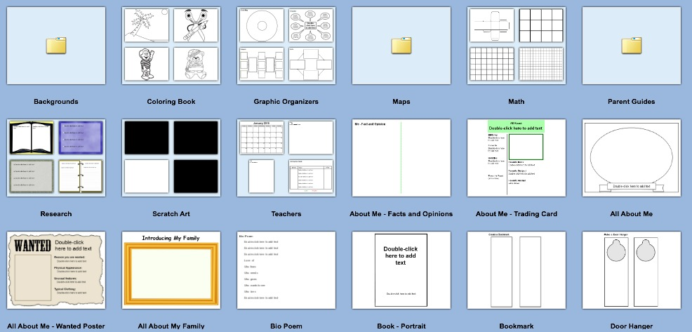
Templates

Slide 56
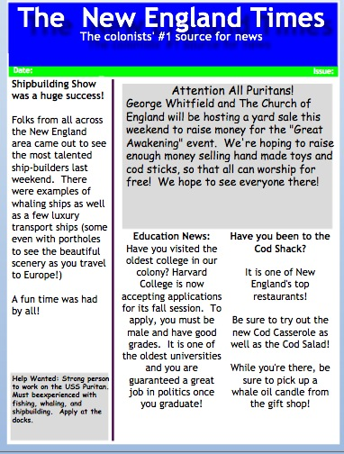

Slide 57
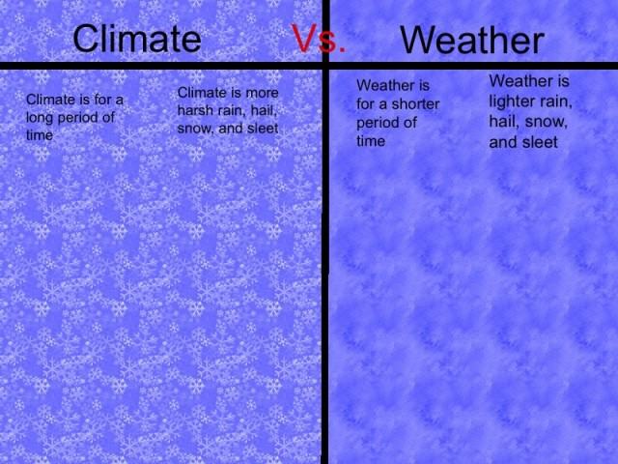

Slide 60
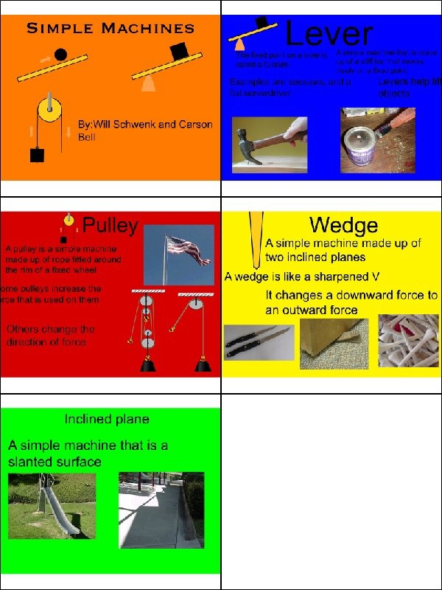
Multiple
Pages

Slide 61
Historical Journal
http://forsyth.wixie.com/u36920

Slide 62
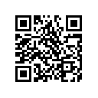
QR~ Scan~Post~ Share
http://padlet.com/sbrandon/GAETC2014

Slide 63
Webquest Resources
Webquest Sites
Webquest Creation Sites
Weebly
Google Sites
Quest Garden
Teacher Web
WikiSpaces
Wix
Zoho
Zunal
Journey to a New Land
TRUST & Digital Citizenship
Quest Garden
Teacher Web
Zunal Webquests
E-Mints Webquests
How to Create a Webquest

